Slide 1
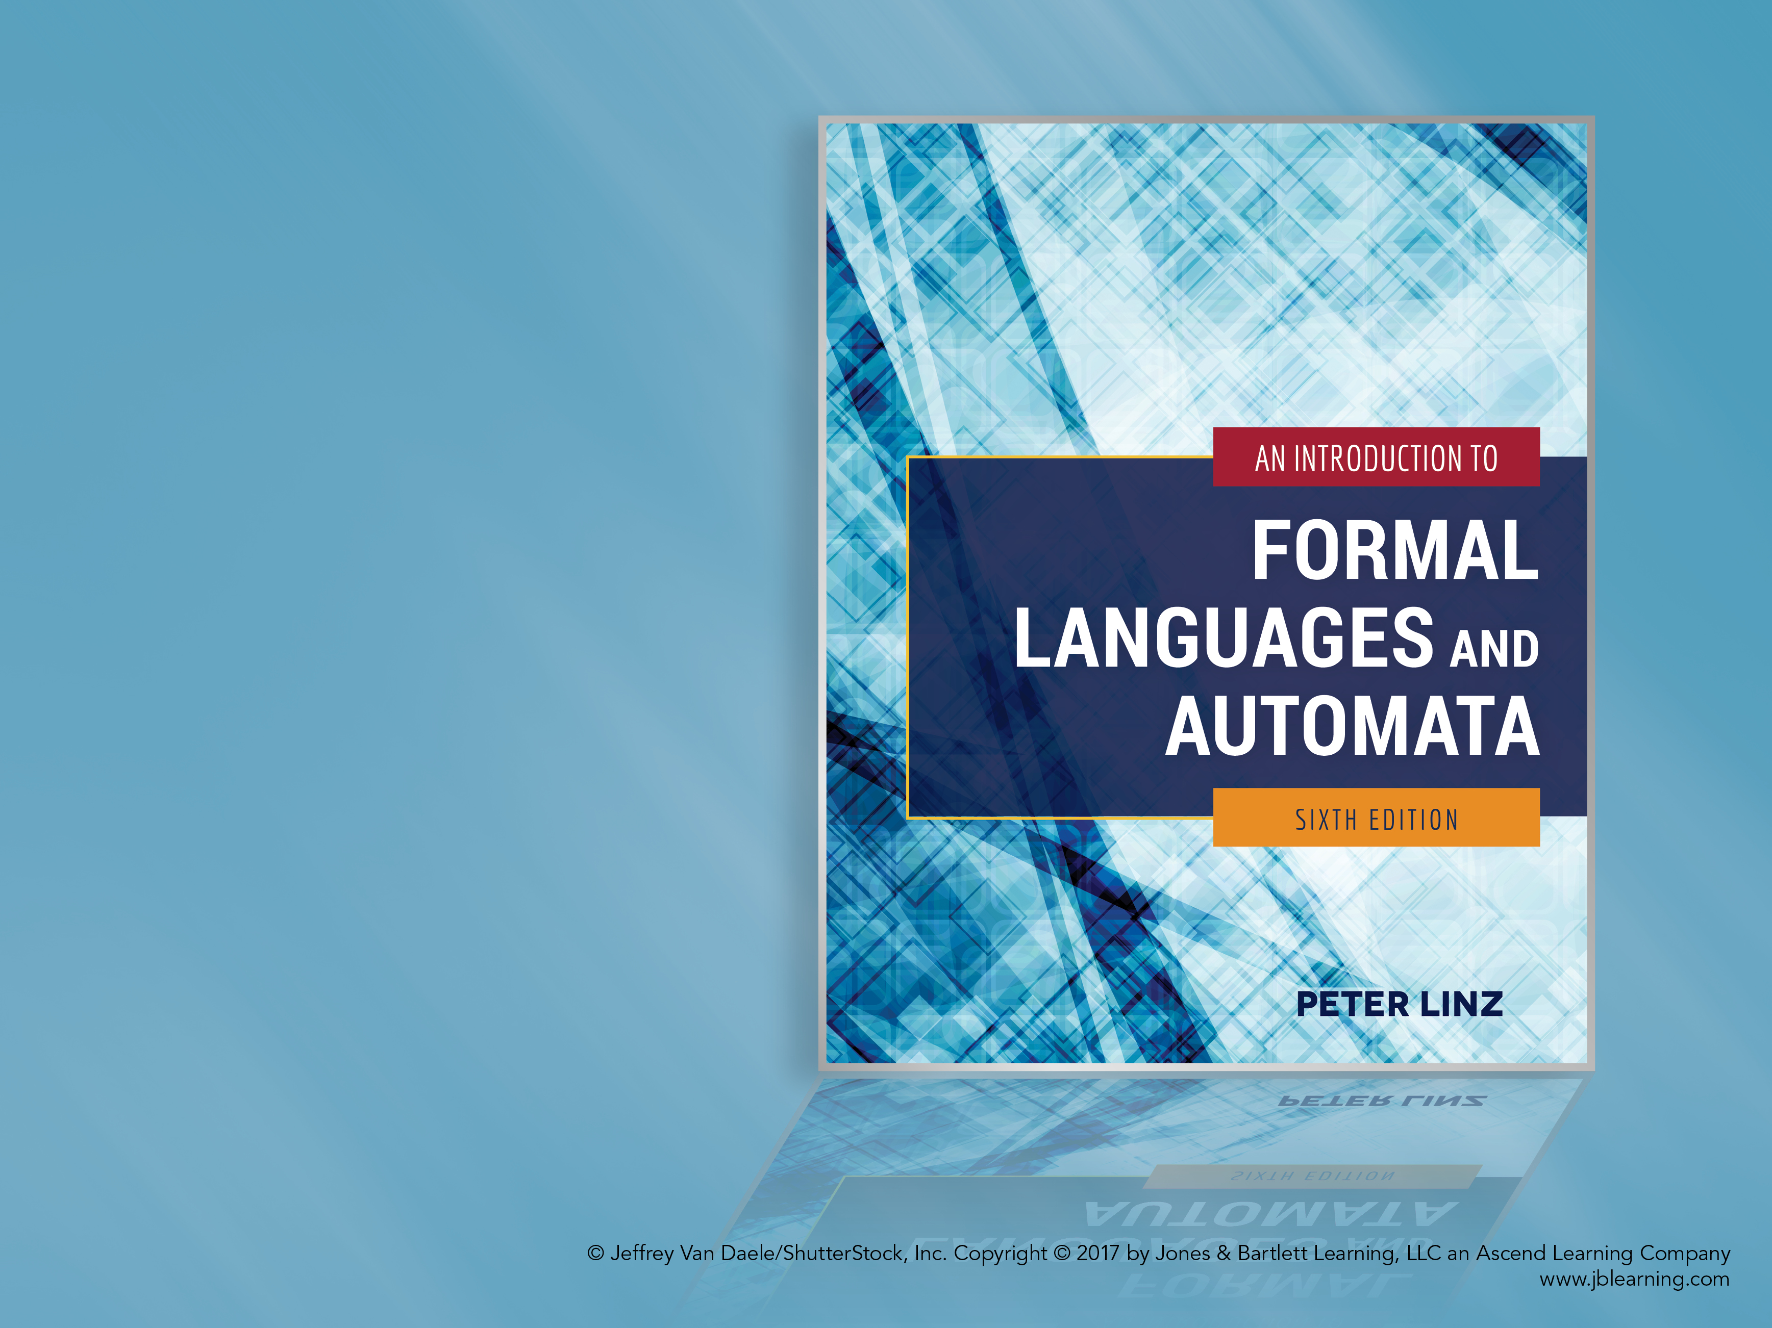
Chapter 5
CONTEXT-FREE LANGUAGES

Slide 2

Learning Objectives At the conclusion of the chapter, the student will be able to:
Identify whether a particular grammar is context-free
Discuss the relationship between regular languages and context-free languages
Construct context-free grammars for simple languages
Produce leftmost and rightmost derivations of a string generated by a context-free grammar
Construct derivation trees for strings generated by a context-free grammar
Show that a context-free grammar is ambiguous
Rewrite a grammar to remove ambiguity

Slide 3
Context-Free Grammars
Many useful languages are not regular
Context-free grammars are very useful for the definition and processing of programming languages
A context-free grammar has no restrictions on the right side of its productions, while the left side must be a single variable
A language is context-free if it is generated by a context-free grammar
Since regular grammars are context-free, the family of regular languages is a proper subset of the family of context-free languages

Slide 4
Context-Free Languages (Example 5.1)
Consider the grammar
V = { S }, T = { a, b }, and productions
S → aSa | bSb | λ
Sample derivations:
S ⇒ aSa ⇒ aaSaa ⇒ aabSbaa ⇒ aabbaa
S ⇒ bSb ⇒ baSab ⇒ baab
The language generated by the grammar is
{ ww^{R}: w ∈ { a, b }*}
(in other words, even-length palindromes in { a, b }*)

Slide 5
Context-Free Languages (Example 5.4)
Consider the grammar
V = { S }, T = { a, b }, and productions
S → aSb | SS | λ
Sample derivations:
S ⇒ aSb ⇒ aaSbb ⇒ aabb
S ⇒ SS ⇒ aSbS ⇒ abS ⇒ abaSb ⇒ abab
The language generated by the grammar is
{ w ∈ { a, b }*: n_{a}(w) = n_{b}(w) and n_{a}(v) ≥ n_{b}(v) }
(where v is any prefix of w)

Slide 6
Leftmost and Rightmost Derivations
In a leftmost derivation, the leftmost variable in a sentential form is replaced at each step
In a rightmost derivation, the rightmost variable in a sentential form is replaced at each step
Consider the grammar from example 5.5:
V = { S, A, B }, T = { a, b }, and productions
S → aAB
A → bBb
B → A | λ
The string abb has two distinct derivations:
Leftmost: S ⇒ aAB ⇒ abBbB ⇒ abbB ⇒ abb
Rightmost: S ⇒ aAB ⇒ aA ⇒ abBb ⇒ abb

Slide 7
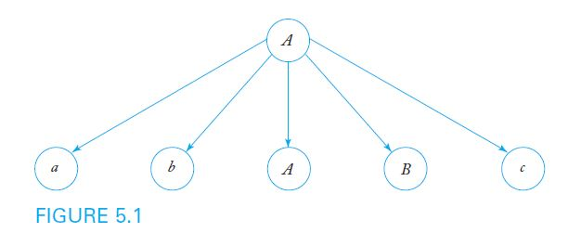
Derivation Trees
In a derivation tree or parse tree,
the root is labeled S
internal nodes are labeled with a variable occurring on the left side of a production
the children of a node contain the symbols on the corresponding right side of a production
For example, given the production A → abABc, Figure 5.1 shows the corresponding partial derivation tree

Slide 8
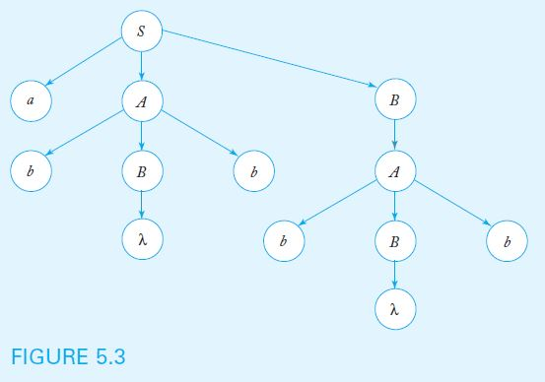
Derivation Trees (Cont.)
The yield of a derivation tree is the string of terminals produced by a leftmost depth-first traversal of the tree
For example, using the grammar from example 5.5, the derivation tree below yields the string abbbb

Slide 9
Sentential Forms and Derivation Trees
Theorem 5.1 states that, given a context-free grammar G, for every string w in L(G), there exists a derivation tree whose yield is w
The converse is also true: the yield of any derivation tree formed with productions from G is in L(G)
Derivation trees show which productions are used in obtaining a sentence, but do not give the order of their application

Slide 10
Parsing and Membership
The parsing problem: given a grammar G and a string w, find a sequence of derivations using the productions in G to produce w
Can be solved in an exhaustive, top-down, but not very efficient fashion
Theorem 5.2: Exhaustive parsing is guaranteed to yield all strings eventually, but may fail to stop for strings not in L(G), unless we restrict the productions in the grammar to avoid the forms A → λ and A → B

Slide 11
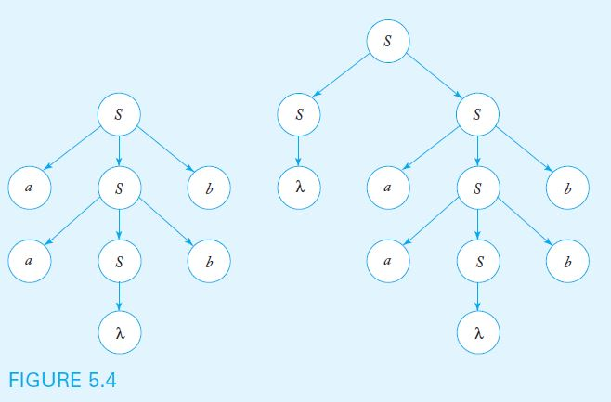
Parsing and Ambiguity
A grammar G is ambiguous if there is some string w in L(G) for which more than one derivation tree exists
The grammar with productions S → aSb | SS | λ is ambiguous, since the string aabb has two derivation trees, as shown below

Slide 12
Ambiguity in Programming Languages
Consider the grammar below, designed to generate simple arithmetic expressions such as (a+b)*c and a*b+c
V = { E, I }, T = { a, b, c, +, *, (, ) }, and productions
E → I
E → E+E
E → E*E
E → (E)
I → a | b | c
The grammar is ambiguous because strings such as a+b*c have more than one derivation tree, as shown in Figure 5.5

Slide 13
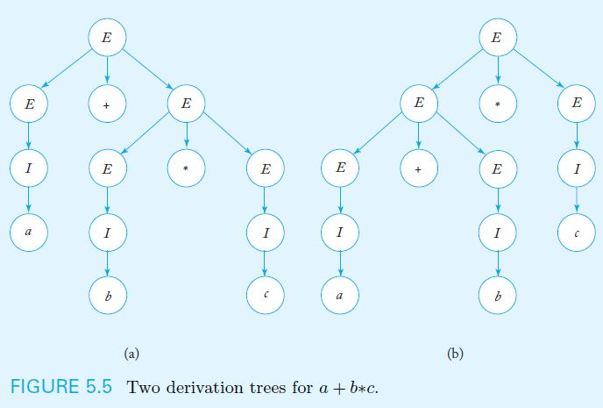
Derivation Trees from Ambiguous Grammar

Slide 14
Resolving Ambiguity
Ambiguity can often be removed by rewriting the grammar so that only one parsing is possible
Consider the grammar
V = { E, T, F, I }, T = { a, b, c, +, *, (, ) }, and productions
E → T
T → F
F → I
E → E+T
T → T*F
F → (E)
I → a | b | c
As shown in Figure 5.6, only one derivation tree yields the string a+b*c

Slide 15
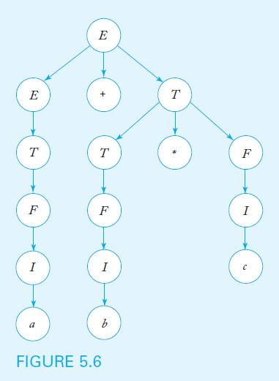
Derivation Tree for a+b*c Using Unambiguous Grammar

Slide 16
Ambiguous Languages
For some languages, it is always possible to find an unambiguous grammar, as shown in the previous example
However, there are inherently ambiguous languages, for which every possible grammar is ambiguous
Consider the language { a^{n}b^{n}b^{m} } ∪ { a^{n}b^{m}b^{m} }, which is generated by the grammar
S → S₁ | S₂
S₁ → S₁c | A
A → aAb | λ
S₂ → aS₂ | B
B → bBc | λ
The grammar above (and every other equivalent grammar) is ambiguous, because any string of the form a^{n}b^{n}b^{m} has two distinct derivations

